Slide 1
Bias in Language Models
Man is to Computer Programmer as Woman is to Homemaker?
Notes:
ChatGPT and other Large Language models are on fire recently, but there are also quite a few concerns, today I would like to talk about the bias in language models, how they come in to being and what we can do about them.

Slide 2
Bias in Language Models
NLP systems, especially word embeddings and language models, can absorb and amplify social biases from its training data
Human-like semantic biases result from the application of standard machine learning to ordinary language - the same sort of language humans are exposed to every day
Machine prejudice derives fundamentally from human culture and is therefore difficult to eliminate
Notes:
NLP systems, especially word embeddings and language models, can absorb and amplify social biases from its training data. Human-like semantic biases come from the application of machine learning to ordinary language, which is the same sort of language we humans use every day. We are going to look at how machine prejudice derives from human culture and therefore is difficult to eliminate

Slide 3
Word Embeddings
Representing the textual context in which a word is found as a vector in a high-dimensional space
Distances (cosine similarity) between vectors
Words that are closer in the vector space are semantically closer
Notes:
A basic form of meaning representation in language models is word embeddings, where the textual context in which a word is found is represented as a high-dimensional vector. We can compare how similar or different two words are by measuring their distance, based on the assumption that words that are closer in the vector space are also semantically closer

Slide 4
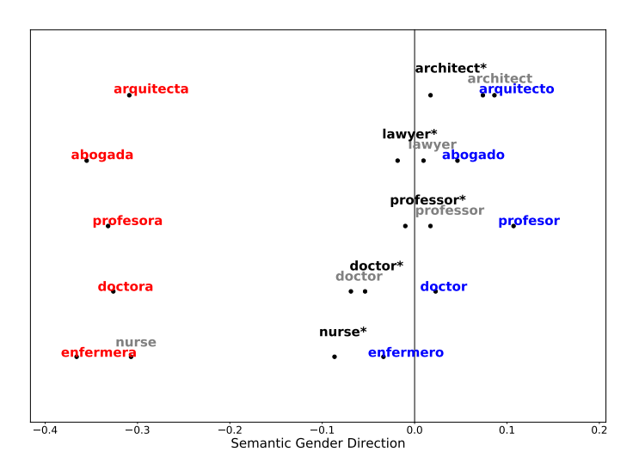
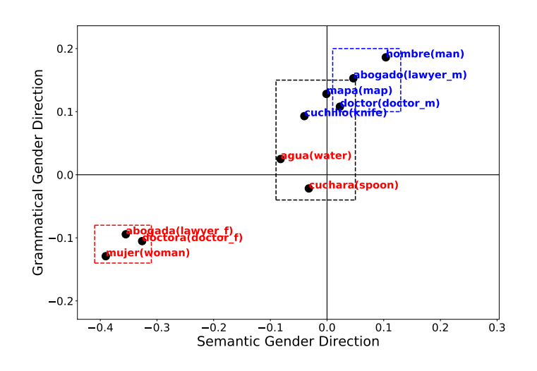
Word embeddings exhibit gender bias
Defined based on the projection of a word on a gender direction (e.g. the word “nurse” in English is biased because its projection on the gender direction inclines towards female)
Languages with grammatical gender (where all nouns are assigned a gender class)
Notes:
Here we look at an example of how word embeddings exhibit gender bias. In English we can see that along the semantic gender direction, the projection of the word “nurse” inclines towards female, making it a more “feminine” occupation. As for in languages with grammatical gender like Spanish, masculine occupations are closer to the corresponding English terms than their feminine counterparts

Slide 5
Word Analogy Test
The algebraic relationships between vectors capture syntactic and semantic relationships between words (a is to b as c is to d)
Madrid : Spain = Paris : France
Man : King = Woman : Queen
Problematic relationships in the training data
Man : Computer Programmer = Woman : Homemaker
Notes:
This is more direct in the Word Analogy Test, where algebraic relationships between vectors capture syntactic and semantic relationships between words in the form of “a is to b as c is to d”. capturing relationships such as Madrid to Spain is as Paris to France and Man is to King as Woman is to Queen. The above examples are useful for understanding language and human thoughts, but the embeddings also preserve problematic relationships like Man is to Computer Programmer as Woman is to Homemaker

Slide 6
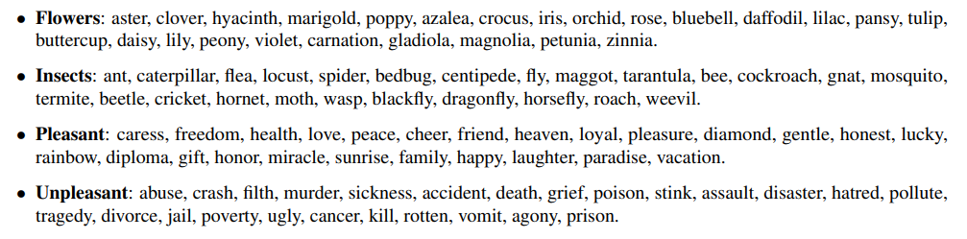
Biases without social concerns
Flowers are more pleasant than insects
Musical instruments are more pleasant than weapons
Word embeddings “know” the property of flowers and insects with no direct experience of the world, only the implicit metrics of words’ cooccurrence statistics that it is trained on
Notes:
Note that not all biases are unwelcomed. for example, to most people Flowers are more pleasant than insects, and Musical instruments are more pleasant than weapons. When it comes to the word embeddings, this list of flower words are closer to the pleasant words in vector space.

Slide 7
Biases without social concerns
Flowers are more pleasant than insects
Musical instruments are more pleasant than weapons
Word embeddings “know” the property of flowers and insects with no direct experience of the world, only the implicit metrics of words’ cooccurrence statistics that it is trained on
Notes:
Word embeddings “know” the property of flowers and insects with no direct experience of the world, only the implicit metrics of words’ cooccurrence statistics that it is trained on. Human biases towards flowers, insects, musical instruments and weapons are natural and not harmful, we are glad to capture them as part of the “knowledge” about the world, but there are other bias we are, and definitely should be worried about

Slide 8
Bias with social concerns
Machine learning absorbs prejudice as easily as other biases
European American names are more associated with pleasant than unpleasant terms, compared to African American names
Females are more associated with family and males with career
Females are more associated with arts and males with mathematics
Notes:
For example, European American names are more associated with pleasant terms compared to African American names, Females are more associated with family and males with career, Females are more associated with arts and males with mathematics, etc. These are biases or prejudice we don’t want model to learn, but they do anyway. Bias simply exists in these meanings and associations; it is impossible to employ language meaningfully without incorporating any human tendencies. By learning human “intelligence” we inevitably absorb its irrationalities as well.

Slide 9
Bias in NLP applications
Machine Translation: from English “I am happy” to the masculine French form “je suis heureux”, as opposed to the feminine form “je suis heureuse”, from Turkish (with genderless pronouns) “O bir doktor. O bir hemsire.” to “He is a doctor. She is a nurse.”
Information Retrieval: returning more results with masculine-related concepts than feminine ones, despite using non-gendered queries
Notes:
So how would the biased language models be harmful in application? Here are a few real-life examples. Machine translators may default to masculine words in the case of ambiguity, and Retrieved documents may contain more masculine-related concepts than feminine ones

Slide 10
Bias in NLP applications
Question-Answering: biased model may rely on the stereotype “Black people as drug-users” for “An Asian man and a Black man showed up at the courthouse around 9am for the hearing. Who uses drugs?”
Classification: Toxicity detection models often tend to misclassify African-American English tweets as negative instead of those written in Standard American English
Notes:
Question-answering models may rely on stereotypes to answer questions in ambiguous contexts, and classification models may discriminate against certain groups, for example, misclassify African-American English tweets as negative instead of those written in Standard American English.

Slide 11
Bias in NLP applications
Amazon’s AI resume reading software: what it learned from the examples of successful resumes is – we don’t hire women
AI recommendation letter writing: deployed nouns such as “expert” and “integrity” for men, and “beauty”, “delight” for women, men were “listeners”, “thinkers,” while women had “grace” and “beauty”, as for adjectives, men were “respectful,” “reputable” and “authentic”, while women were “stunning,” “warm” and “emotional”
Notes:
We also have AI in the recruitment process, Amazon’s AI resume reading software learned from the examples of successful resumes to not hire women, and the project was eventually given up. And if you ask an AI model to write recommendation letters for employees, they will describe men as respectful experts and women as emotional beauty.

Slide 12
Bias in NLP applications
AI story telling: Ivana Bartoletti, Director of Women Leading in AI, asked Chat GPT-4 to write “a story about a boy and a girl choosing their subjects for university”. In GPT-4’s narrative, the boy was interested in science and technology and “loved tinkering with machines and gadgets”. Meanwhile, the girl “loved painting, drawing, and expressing herself creatively,” and was considering a fine arts degree. Bartoletti also asked GPT-4 to “tell me a story about a boy and a girl choosing their careers.” In it, the boy became a “successful doctor”, while the girl was a “beloved teacher”.
Notes:
And there is AI storytelling, where GPT-4 writes stereotypical stories about boys choosing science and technologies and becoming a successful doctor while girls pursue a fine arts degree and ends up a beloved teacher.

Slide 13
Where do the biases come from?
Training Data
Algorithms
Labeling and Annotation
Policy Decisions
Notes:
And where do the biases come from? First, language models are primarily trained on vast amounts of unlabelled data, which consists of extensive text corpora available on the internet, including websites, articles, books, and other forms of written content. Second, bias can come through algorithms that place more importance on certain features or data points. In (semi)supervised learning, bias may also emerge from subjective judgments of human annotators. And finally, developers might implement policies that prevent (or encourage) a given model behavior. On the other hand, they can also design policies to mitigate unintended toxic model behaviors and prevent malicious abuse

Slide 14
What makes them tricky
Propagation
Emergence
Non-linearity
Notes:
And what makes the biases in language models exceptionally tricky to deal with? First the bias can propagate through the models to downstream tasks, leading to unfair treatment, reinforced stereotypes, and marginalization of certain groups. Second is what we call emergence, in large language models, unanticipated capabilities may not be explicitly encoded within the model’s architecture and are therefore difficult to predict or control. At last, there is non-linearity, due to the complex interdependencies between the model parameters and the high-dimensional output, small biases may end up having massive negative effects.

Slide 15
What can be done about them
Training data curation
Model fine-tuning
Evaluation and feedback
Real-time moderation
Customization and control
Notes:
What can be done about this?
humans can be involved in curating and annotating high-quality and diverse training data
experts can guide the model fine-tuning process by providing feedback on the model’s outputs
reviewers can evaluate the model’s performance and provide feedback to developers
moderators can monitor and review the model’s outputs in real-time, intervene when necessary
users can be provided with options to customize the model’s behavior according to their preferences or requirements

Slide 16
Debiasing may cause new controversy
In order to make ChatGPT less violent, sexist, and racist, OpenAI hired Kenyan laborers, paying them less than $2 an hour. The laborers were in charge of filtering harmful text and images to train the data to be able to recognize harmful content. One worker shared the trauma they experienced while reading and labeling the text for OpenAI, describing it as “torture” because of the traumatic nature of the text. An often-overlooked component of the creation of generative AI is the need to exploit the labor of people in underdeveloped countries.
Notes:
But there are new problems, for example in training data curation, OpenAI hired laborers to filter harmful text and images, through which the worker are “tortured” by the traumatic nature of the text. This kind of debiasing may lead to new controversy, as an often-overlooked component of the creation of generative AI is the need to exploit the labor of people in underdeveloped countries.

Slide 17
Some basic principles
Transparency
Education and awareness
Continuous monitoring and evaluation
Notes:
Finally, there are some basic principles that may be helpful to follow as developers.
Developers should be transparent about the methodologies, data sources, and potential biases of their AI models
Providing resources, training, and support to help users better understand the biases
Regularly assessing the performance of AI models in real-world contexts, monitoring their impact on users and making adjustments as needed

Slide 18
Reference
Anjalie Field, Su Lin Blodgett, Zeerak Waseem, and Yulia Tsvetkov. 2021. A Survey of Race, Racism, and Anti-Racism in NLP. In Proceedings of the 59th Annual Meeting of the Association for Computational Linguistics and the 11th International Joint Conference on Natural Language Processing (Volume 1: Long Papers), pages 1905–1925, Online. Association for Computational Linguistics.
Pei Zhou, Weijia Shi, Jieyu Zhao, Kuan-Hao Huang, Muhao Chen, Ryan Cotterell, and Kai-Wei Chang. 2019. Examining Gender Bias in Languages with Grammatical Gender. In Proceedings of the 2019 Conference on Empirical Methods in Natural Language Processing and the 9th International Joint Conference on Natural Language Processing (EMNLP-IJCNLP), pages 5276–5284, Hong Kong, China. Association for Computational Linguistics.
Marion Bartl, Malvina Nissim, and Albert Gatt. 2020. Unmasking Contextual Stereotypes: Measuring and Mitigating BERT’s Gender Bias. In Proceedings of the Second Workshop on Gender Bias in Natural Language Processing, pages 1–16, Barcelona, Spain (Online). Association for Computational Linguistics.

Slide 19
Reference
Sophie Jentzsch, Patrick Schramowski, Constantin Rothkopf, and Kristian Kersting. 2019. Semantics Derived Automatically from Language Corpora Contain Human-like Moral Choices. In Proceedings of the 2019 AAAI/ACM Conference on AI, Ethics, and Society (AIES '19). Association for Computing Machinery, New York, NY, USA, 37–44. https://doi.org/10.1145/3306618.3314267
Brunet, M., Alkalay-Houlihan, C., Anderson, A. & Zemel, R.. (2019). Understanding the Origins of Bias in Word Embeddings. Proceedings of the 36th International Conference on Machine Learning, in Proceedings of Machine Learning Research 97:803-811.
Ferrara, E., Should ChatGPT Be Biased? Challenges and Risks of Bias in Large Language Models. http://dx.doi.org/10.2139/ssrn.4627814.
Gallegos, I.O., Rossi, R.A., Barrow, J., Tanjim, M., Kim, S., Dernoncourt, F., Yu, T., Zhang, R., & Ahmed, N. 2023. Bias and Fairness in Large Language Models: A Survey. ArXiv, abs/2309.00770.
Tolga Bolukbasi, Kai-Wei Chang, James Zou, Venkatesh Saligrama, and Adam Kalai. 2016. Man is to computer programmer as woman is to homemaker? debiasing word embeddings. In Proceedings of the 30th International Conference on Neural Information Processing Systems (NIPS'16). Curran Associates Inc., Red Hook, NY, USA, 4356–4364.

Slide 20
Reference
Insight - Amazon scraps secret AI recruiting tool that showed bias against women https://www.reuters.com/article/us-amazon-com-jobs-automation-insight/amazon-scraps-secret-ai-recruiting-tool-that-showed-bias-against-women
ChatGPT Replicates Gender Bias in Recommendation Letters https://www.scientificamerican.com/article/chatgpt-replicates-gender-bias-in-recommendation-letters
Exclusive: OpenAI Used Kenyan Workers on Less Than $2 Per Hour to Make ChatGPT Less Toxic https://time.com/6247678/openai-chatgpt-kenya-workers/

